Slide 1
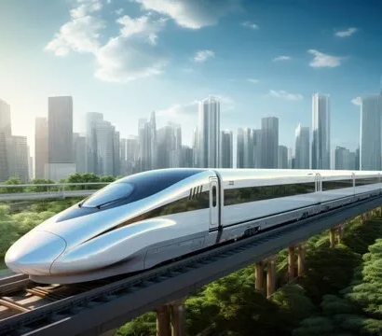
Railway Reservation System
Aadithya s (23MID0403)
Harshitha(23MID0378)
Danasri M S(23MIC0068

Slide 2
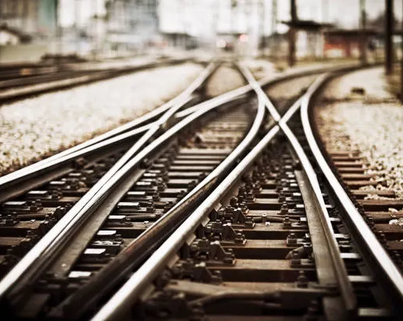
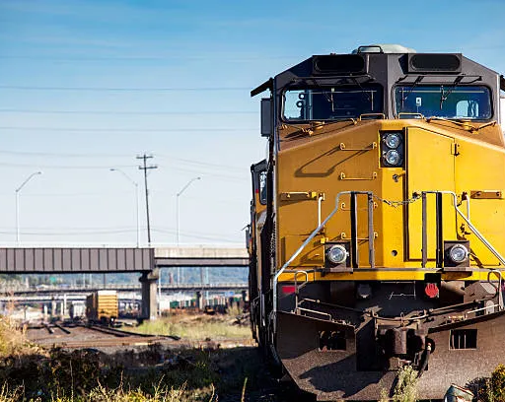
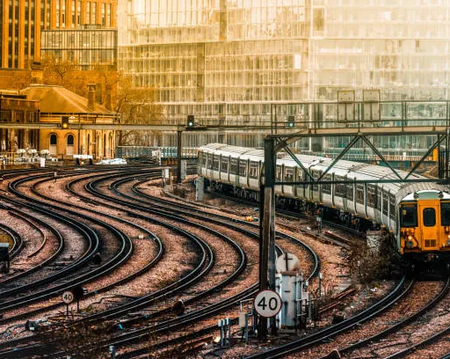
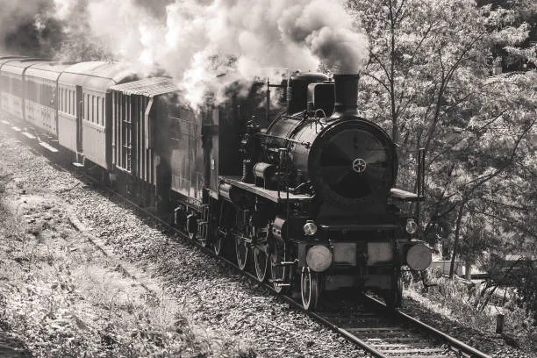
Agenda
Introduction
Objectives
System Features
Technology Stack
ER Diagram & Database Design
Screenshots/Wireframes
Future Enhancements
Conclusion

Slide 3
Introduction
Purpose of the project railway reservation system
Problems with current manual systems
Benefits of the proposed system

Slide 4
Purpose of the project railway reservation system
The Railway Reservation System is designed to digitize and streamline the process of booking, managing, and canceling train tickets. Its primary purposes include:
1. Automating Ticket Booking
Eliminate long queues at ticket counters.
Allow passengers to book tickets online anytime, anywhere.
2. Real-Time Seat Availability & Scheduling
Provide up-to-date information on train schedules, seat availability, and fares.
Reduce conflicts from overbooking or manual errors.
3. Secure & Convenient Payments
Integrate online payment gateways (UPI, credit/debit cards, net banking).
Ensure secure transactions with encryption and OTP verification.
4. E-Tickets & Digital Records
Generate e-tickets (PDF/QR codes) to reduce paper waste.
Store booking history for easy access and refunds.

Slide 5
Problems with current manual systems
1. Long Queues & Waiting Time
Passengers must stand in long lines at ticket counters.
Peak hours (festivals, holidays) worsen delays.
Time-consuming process for both travelers and staff.
2. Human Errors in Bookings
Manual entry leads to wrong names, dates, or seat numbers.
Miscommunication between staff and passengers.
Overbooking due to lack of real-time updates.
3. Limited Accessibility
Only available at physical counters during working hours.
Remote/rural areas lack sufficient booking centers.
No 24/7 service (unlike online systems).
How the Digital Railway Reservation System Solves These Problems
✔ Online 24/7 bookings → No queues. ✔ Automated seat allocation → No overbooking. ✔ E-tickets & QR codes → No fraud. ✔ Instant refunds → Transparent process. ✔ Real-time tracking → Better passenger experience.

Slide 6
Benefits of the proposed system
1. Faster & Hassle-Free Booking
✅ 24/7 Online Access – Book tickets anytime from anywhere. ✅ No Long Queues – Eliminates physical counter delays. ✅ Instant Confirmation – E-tickets generated in seconds.
2. Real-Time Seat Availability & Scheduling
✅ Live Updates – Passengers see available seats, train delays, and alternative routes. ✅ Dynamic Pricing – Automatic fare adjustments based on demand.
3. Secure & Multiple Payment Options
✅ UPI, Cards, Wallets – Supports all digital payment modes. ✅ Encrypted Transactions – Reduces fraud risks.
4. E-Tickets & Digital Records
✅ Paperless Travel – QR-based e-tickets reduce environmental waste. ✅ Booking History – Passengers can access past trips anytime.
5. Easy Cancellations & Refunds
✅ Self-Service Cancellation – No need to visit counters. ✅ Automated Refunds – Faster processing to bank accounts.

Slide 7
Benefits of the proposed system
1. Faster & Hassle-Free Booking
✅ 24/7 Online Access – Book tickets anytime from anywhere. ✅ No Long Queues – Eliminates physical counter delays. ✅ Instant Confirmation – E-tickets generated in seconds.
2. Real-Time Seat Availability & Scheduling
✅ Live Updates – Passengers see available seats, train delays, and alternative routes. ✅ Dynamic Pricing – Automatic fare adjustments based on demand.
3. Secure & Multiple Payment Options
✅ UPI, Cards, Wallets – Supports all digital payment modes. ✅ Encrypted Transactions – Reduces fraud risks.
4. E-Tickets & Digital Records
✅ Paperless Travel – QR-based e-tickets reduce environmental waste. ✅ Booking History – Passengers can access past trips anytime.
5. Easy Cancellations & Refunds
✅ Self-Service Cancellation – No need to visit counters. ✅ Automated Refunds – Faster processing to bank accounts.

Slide 8
Objectives
1. Primary Objectives (Core Functionalities)
✔ Online Ticket Booking – Allow passengers to book tickets anytime, anywhere via web/mobile. ✔ Real-Time Seat Availability – Show live updates on train schedules and seat status. ✔ Secure Payments – Integrate UPI, cards, wallets with encrypted transactions. ✔ E-Ticket Generation – Provide digital tickets (PDF/QR codes) to reduce paper use.
2. Passenger-Centric Objectives
✔ User-Friendly Interface – Simple navigation for all age groups. ✔ Multi-Language Support – Cater to diverse users (Hindi, English, regional languages). ✔ Accessibility – Support for disabled users (screen readers, voice commands).
3. Railway Management Objectives
✔ Automated Scheduling – Optimize train routes and timings based on demand. ✔ Fraud Prevention – Stop black marketing via OTP/biometric verification. ✔ Data Analytics – Generate reports on occupancy, revenue, peak travel times. ✔ Staff Efficiency – Reduce manual workload for railway employees.

Slide 9
System Features
User Roles: Admin, Passenger
Key Functions:
User registration/login
Train search (source, destination, date)
Seat selection
Meal Selection
Online payment (UPI, cards, wallets)
Admin Panel: Train scheduling, user management, analytics

Slide 10
Technology Stack
Frontend: HTML/CSS, JavaScript
Backend: Node JS
APIs: Payment gateway (Razorpay/Paytm)
Tools: Figma (UI design)

Slide 11
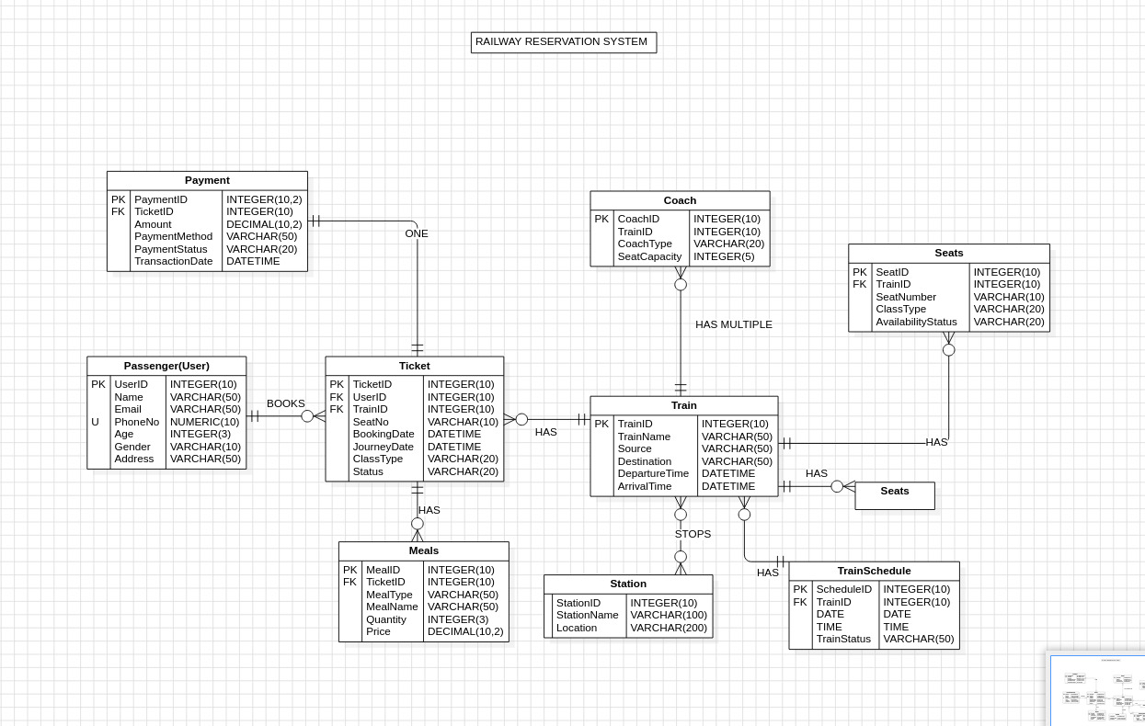
ER Diagram & Database Design

Slide 12
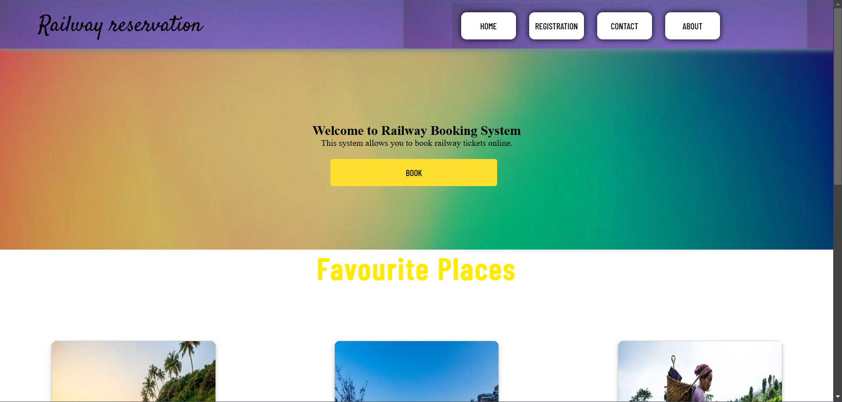
Screenshots/Wireframes

Slide 13
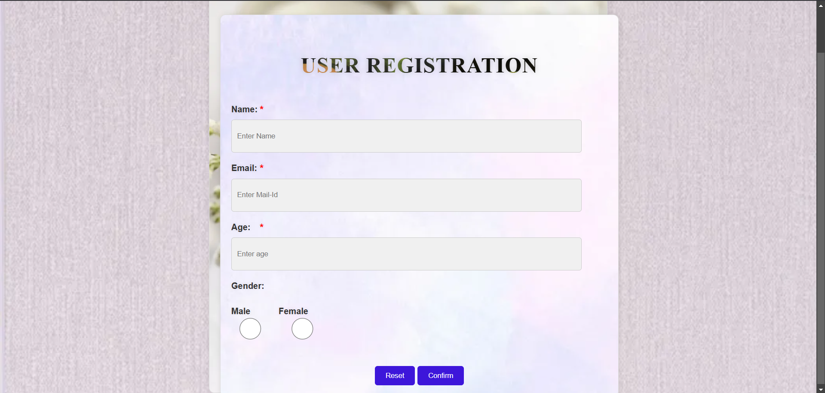
Screenshots/Wireframes

Slide 14
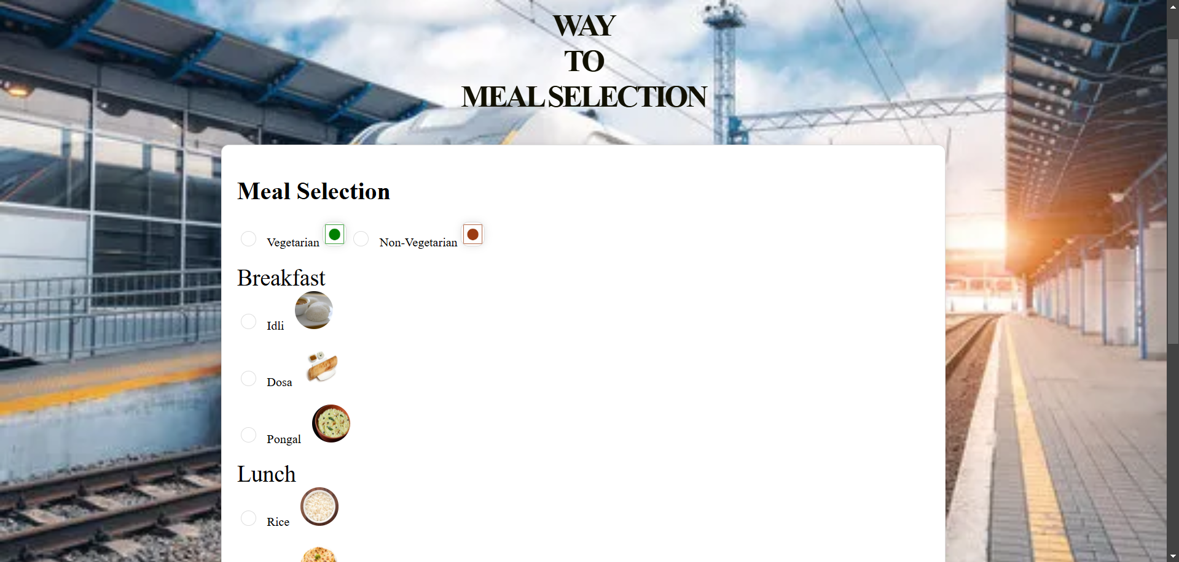
Screenshots/Wireframes

Slide 15
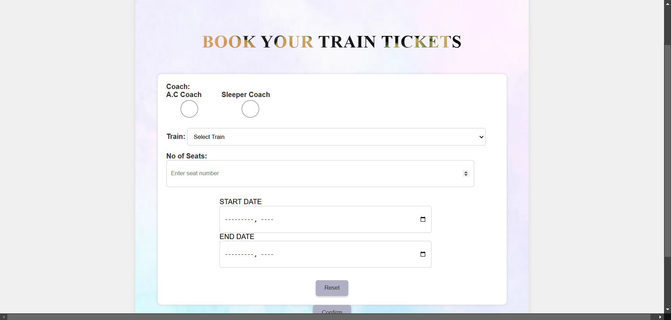
Screenshots/Wireframes

Slide 16
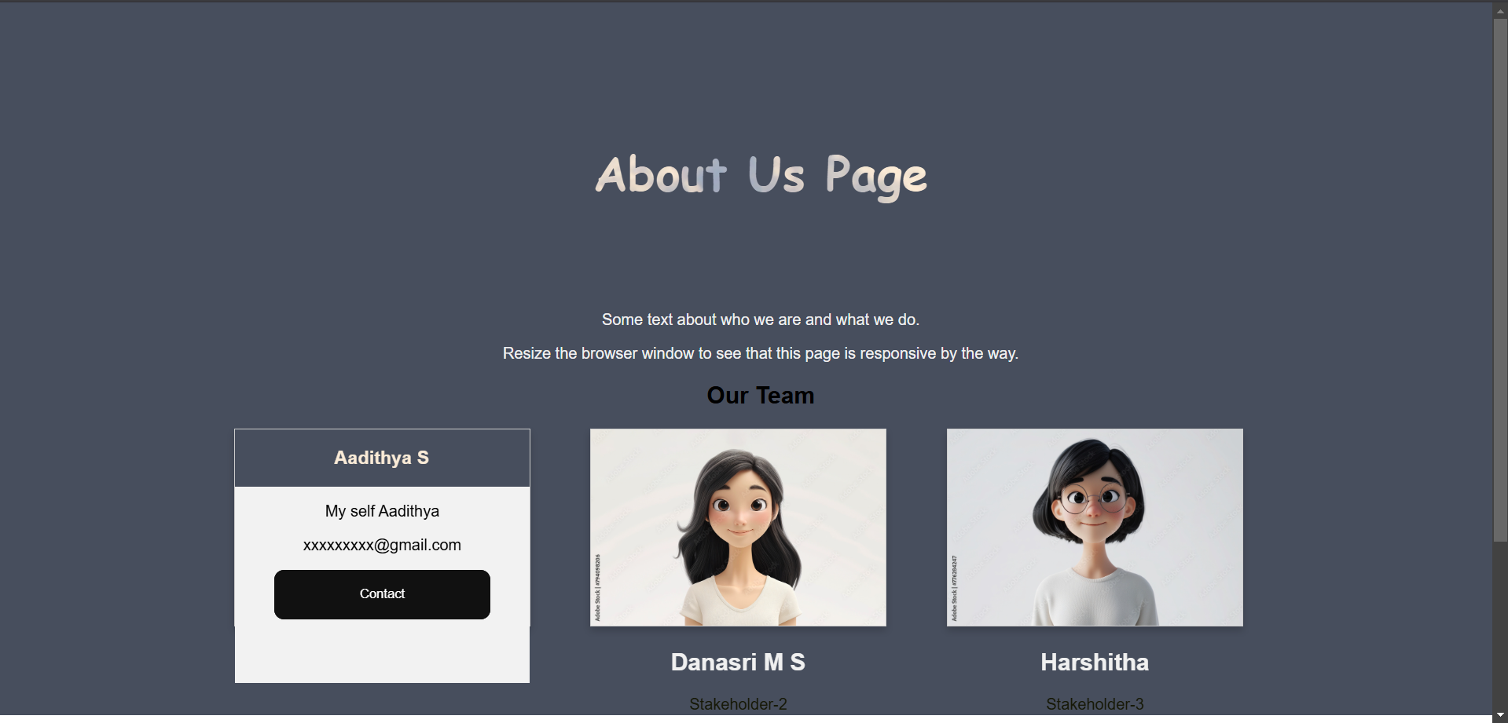
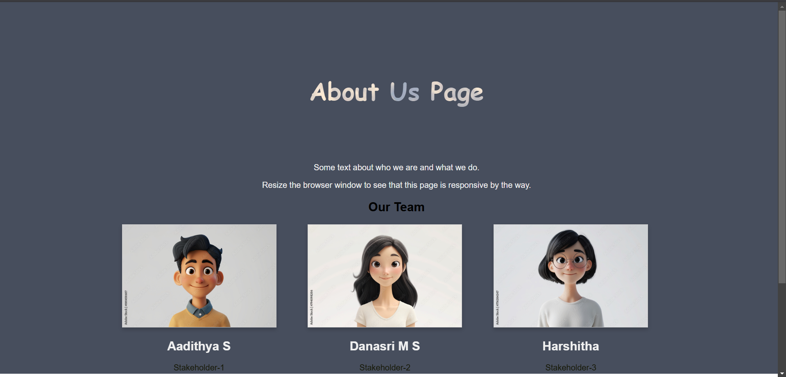
Screenshots/Wireframes

Slide 17
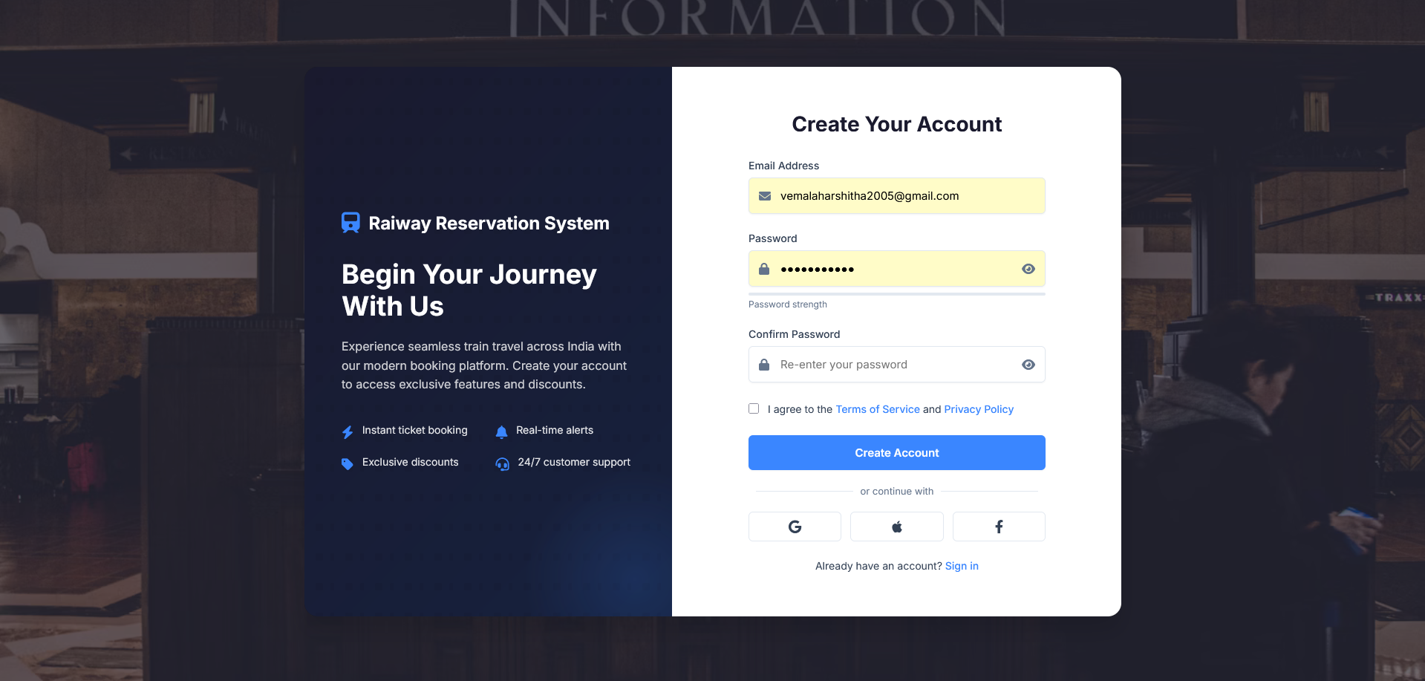
Screenshots/Wireframes

Slide 18
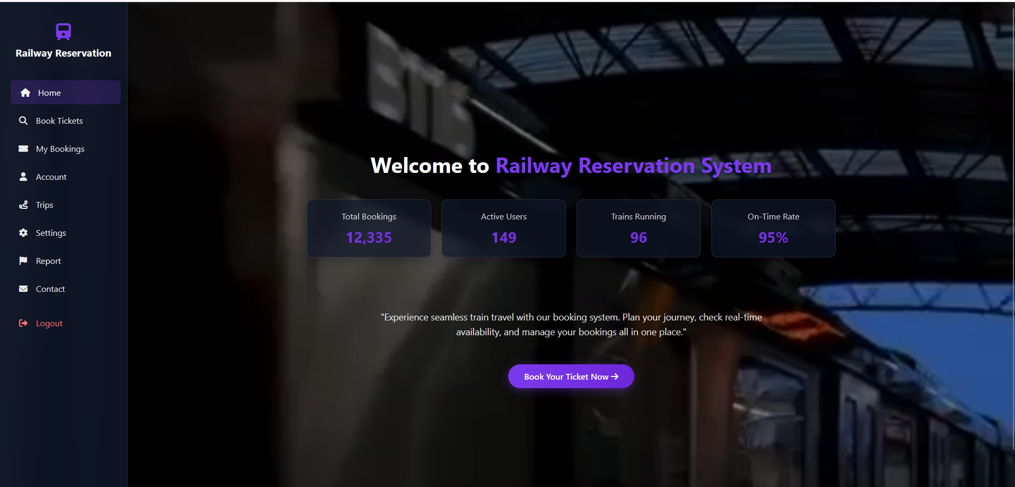
Screenshots/Wireframes

Slide 19
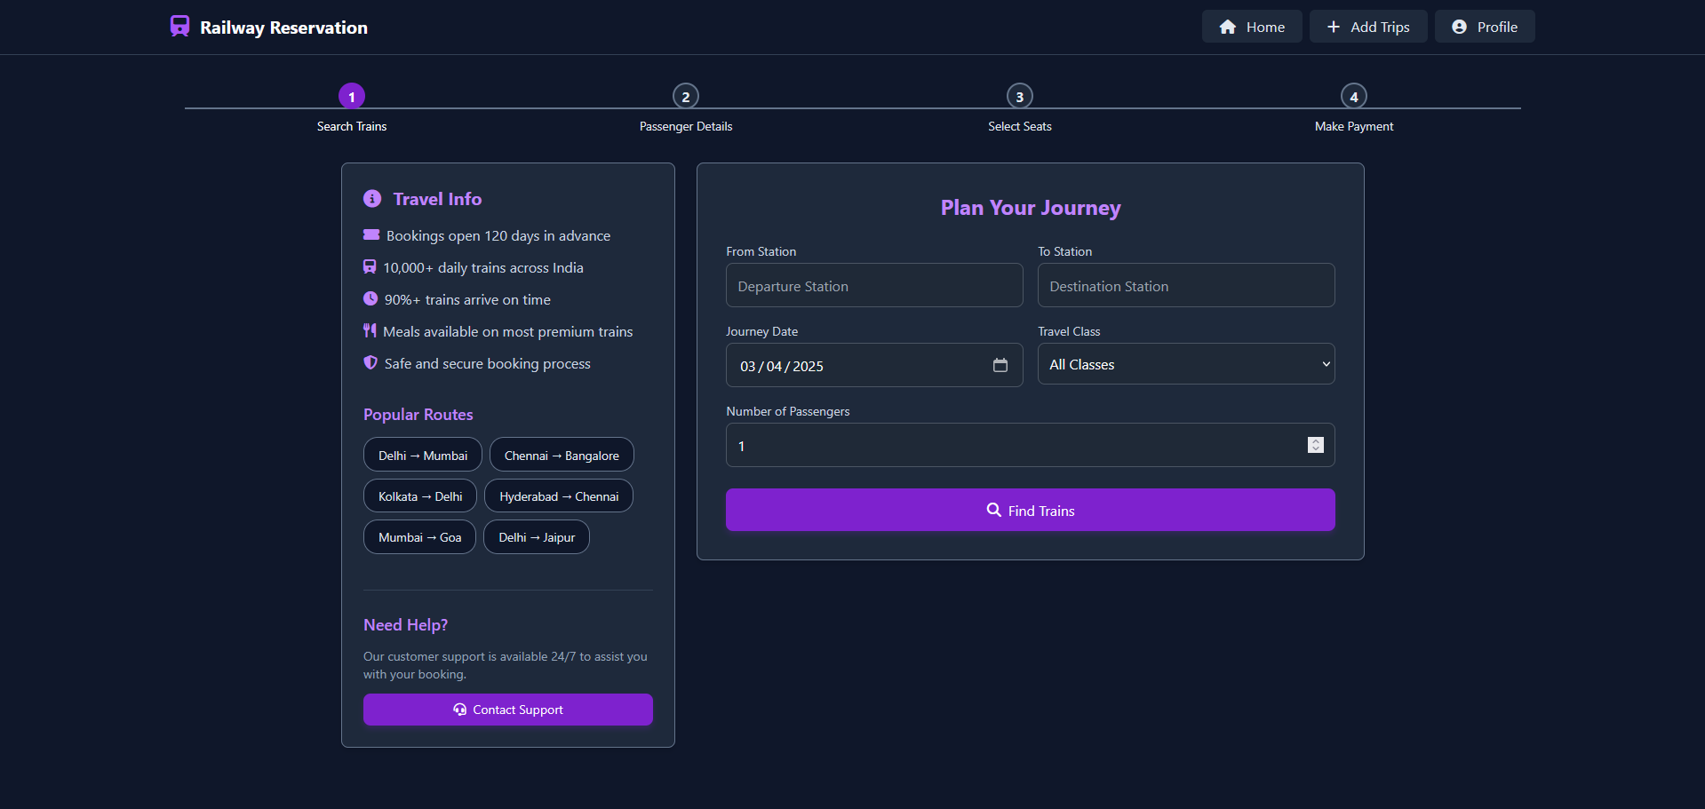
Screenshots/Wireframes

Slide 20
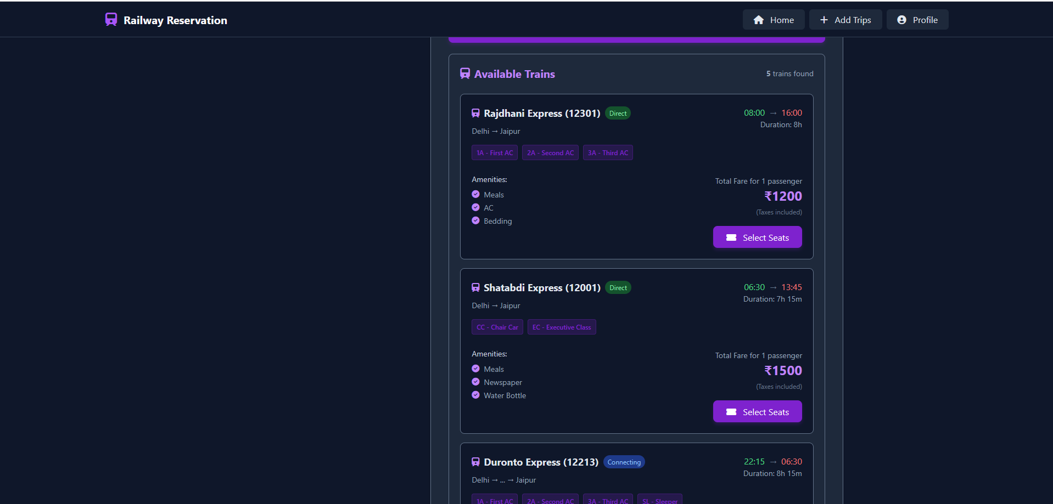
Screenshots/Wireframes

Slide 21
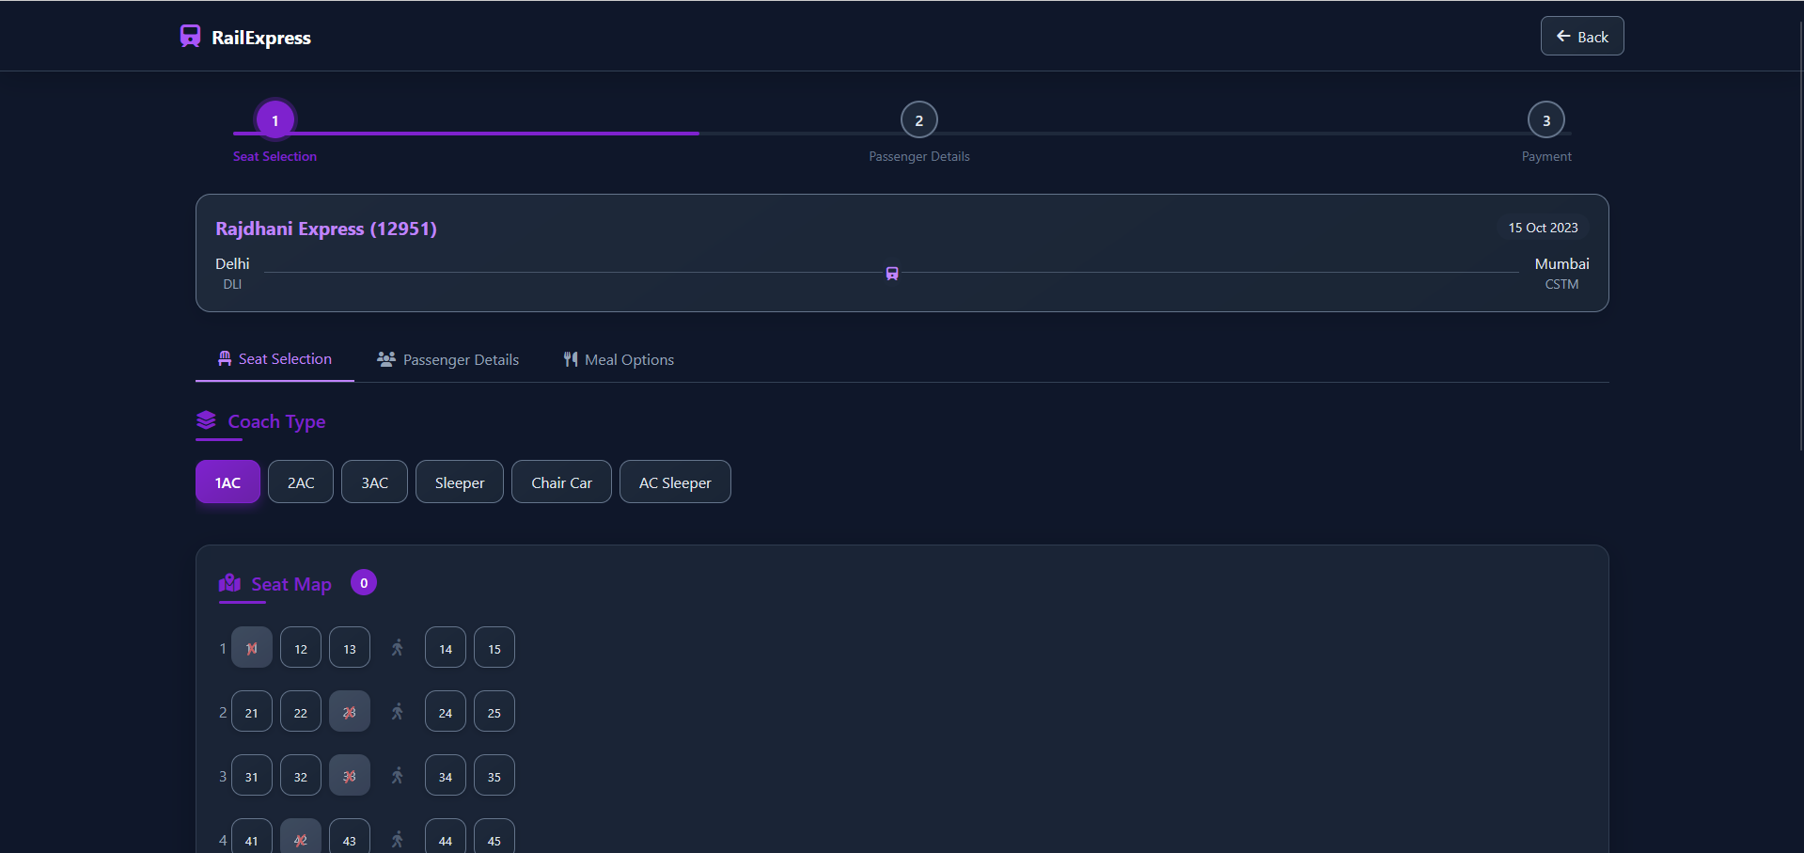
Screenshots/Wireframes

Slide 22
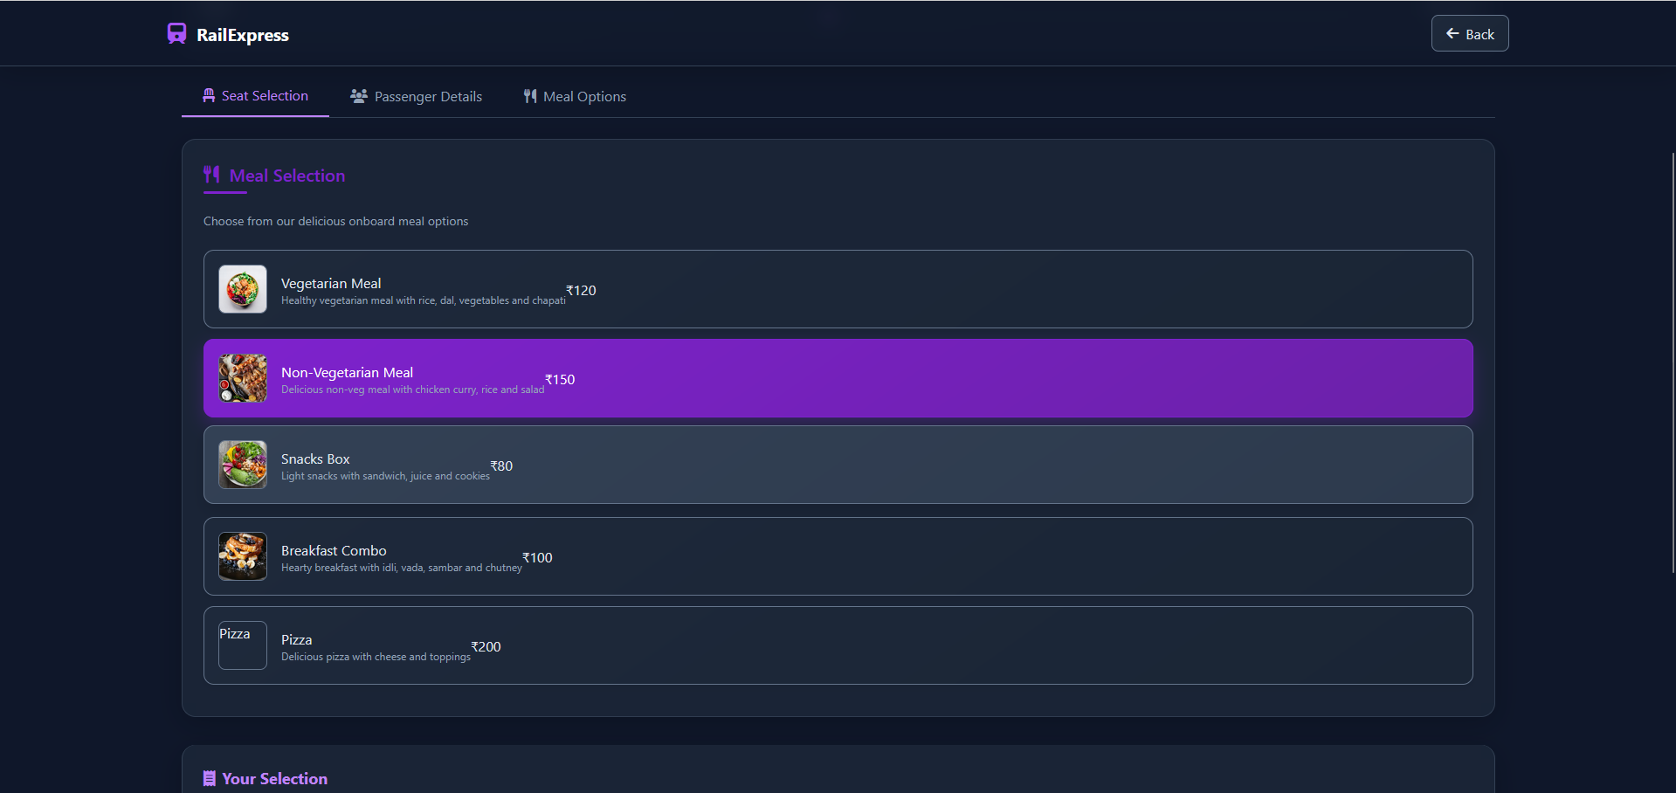
Screenshots/Wireframes

Slide 23
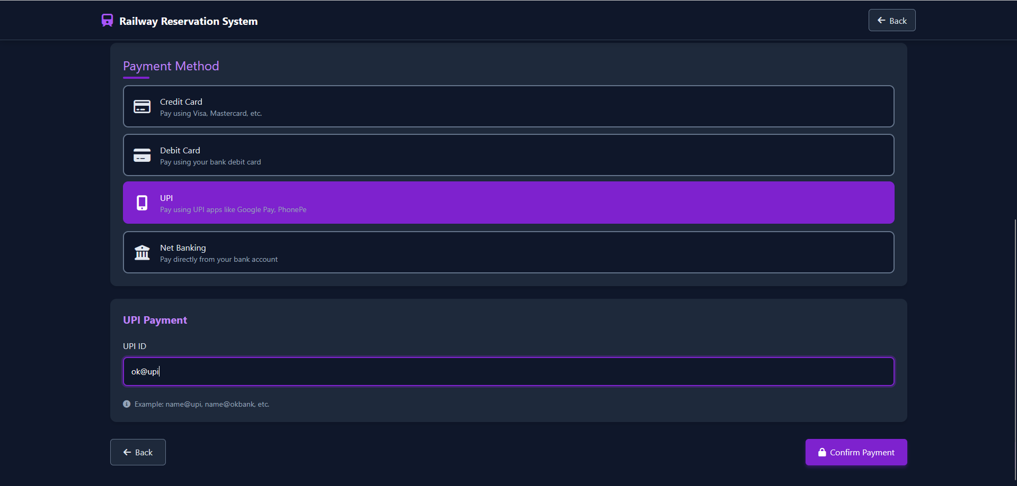
Screenshots/Wireframes

Slide 24
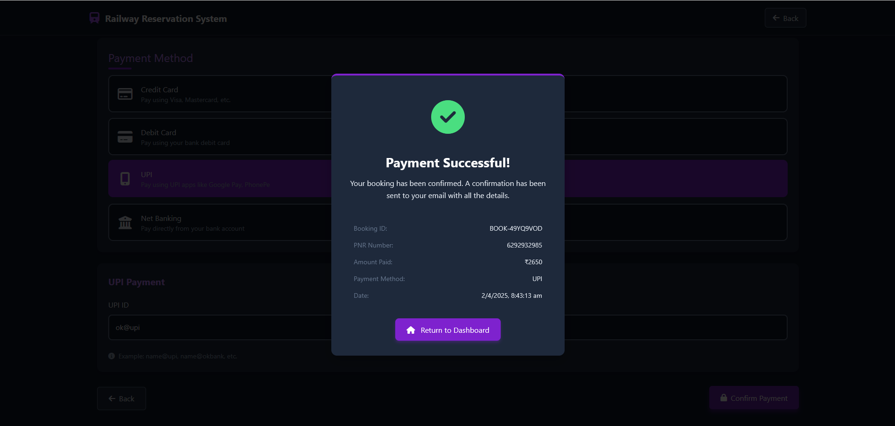
Screenshots/Wireframes

Slide 25
Conclusion
The Railway Reservation System is a modern, efficient, and user-friendly solution designed to transform traditional train ticket booking into a fast, secure, and hassle-free digital experience. By leveraging web/mobile technologies, real-time databases, and secure payment gateways, this system successfully addresses the limitations of manual reservation methods, such as long queues, human errors, fraud risks, and inefficiencies.
Key Achievements
✔ Automated ticket booking & cancellation – Reducing dependency on physical counters. ✔ Real-time seat availability & PNR tracking – Enhancing passenger convenience. ✔ Secure digital payments & e-tickets – Minimizing fraud and paper waste. ✔ Admin dashboard & analytics – Helping railways optimize operations and revenue.
Impact of the Project
✅ For Passengers – Faster bookings, instant refunds, and 24/7 accessibility. ✅ For Railways – Reduced operational costs, better crowd management, and data-driven decision-making. ✅ For the Environment – Paperless tickets contribute to sustainability.

Slide 26



Team
Aadithya S
Danasri M S
Harshitha
Stake holder-1
23MID0403
Stake holder-2
23MIC0068
Stake holder-3
23MID378

Slide 27

Thank you
Harshitha 23MID0378
Aadithya S 23MID0403
Danasri M S 23MIC0068

